Slide 1

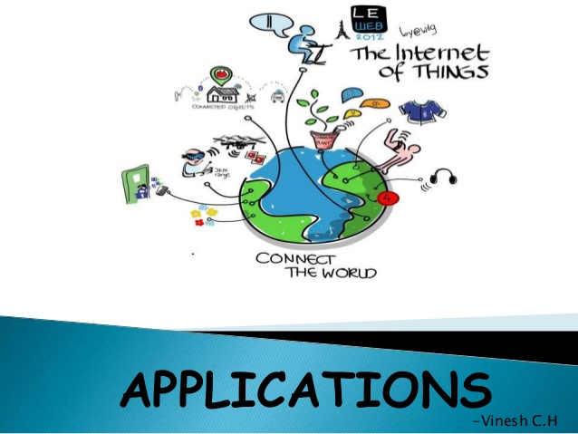
B.N.M. Institute of Technology Approved by AICTE, Affiliated to VTU, Accredited as grade A Institution by NAAC. All UG branches – CSE, ECE, EEE, ISE & Mech.E accredited by NBA for academic years 2018-19 to 2020-21 & valid upto 30.06.2021 Post box no. 7087, 27th cross, 12th Main, Banashankari 2nd Stage, Bengaluru- 560070, INDIA Ph: 91-80- 26711780/81/82 Email: principal@bnmit.in, www. bnmit.org
SKILL DEVELOPMENT PROGRAMME
on
Internet of Things
Organized by
Department of Computer Science & Engineering

Slide 2
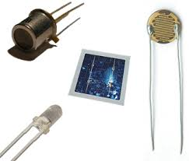
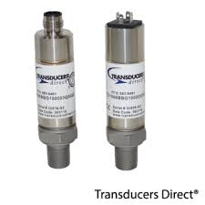
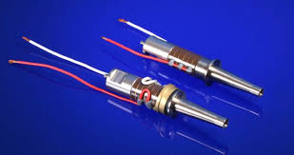
Introduction to
Transducers and Sensors

Slide 3
Transducers: A component which converts one form of energy into another form.
Industrial application: Includes varieties of sensors to measures pressure, liquid levels, electric conductivity, force etc.,
Motion control application where transducers can be any one of the sensor in a group of sensors such as rotary or linear encoders for positional feedback.

Slide 4
Sensors: A component which detects and responds to some type of inputs from the outside environment.
An input can be intensity of Light, motion of a device, Pressure of a system or any other environmental phenomenon.
Actuators: A component which has a tendency of moving or actuating a mechanism of a system, basically converting energy into motion or in form of mechanical energy.

Slide 5
Workflow of Transducers in a system
IIInput
Sensing Element
TTransduction element
Output

Slide 6
Classification of Transducers
Primary Transducers
Secondary Transducers
Analog Transducers
Digital Transducers
Electrical Transducers
Mechanical Transducers
Active Transducers
Passive Transducers
Electrochemical Transducers
Electromechanical Transducers

Slide 7
Workflow of a Sensors in a system
Sensing Unit
Controlling System
Controller
Actuating Unit

Slide 8
Classification of Sensors
1) Analog Sensors
Pros:
Good Lifespan
Not Expensive and easy to handle.
Configuring fault components is easier.

Slide 9
Cons:
Analog sensors poses unwanted variation when noise gets added.
Security is not there for transmitting data.
Saving data when needed ids prone to errors.

Slide 10
2) Digital Sensors
Pros:
Easy to implement because they are free from observational errors.
They are noise immune without any deterioration.
Security can include great encryption transmission.

Slide 11
Cons:
Less accurate because its sample analog wave forms into few numbers and records them.
Higher cost
Sampling Error is most common in many cases.

Slide 12
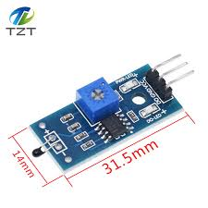
Types of Sensors
1) Thermal sensors

Slide 13
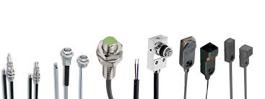
2) Mechanical Sensors

Slide 14
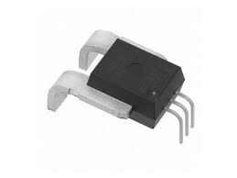
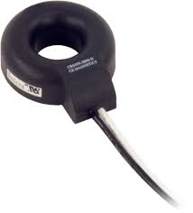
3) Electrical Sensors

Slide 15
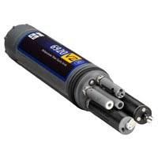
4) Chemical Sensors

Slide 16
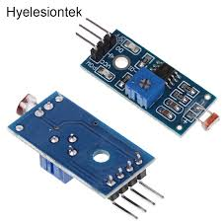
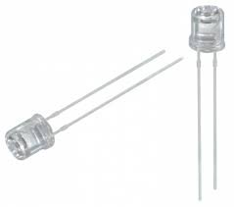
5) Optical Light Sensors

Slide 17
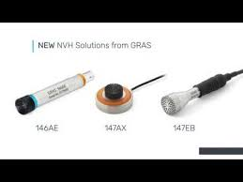
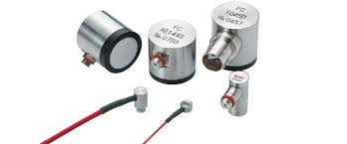
6) Acoustic

Slide 18
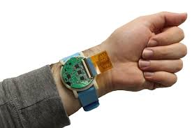
7) Biological Sensor

Slide 19
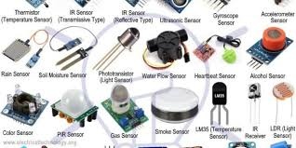
Different types of Sensor

Slide 20
Actuators
Actuators are natural complements to sensors.
Actuators will receive some type of control signal (commonly an electric signal or digital command) that triggers a physical effect, usually some type of motion, force, and so on.
20

Slide 21
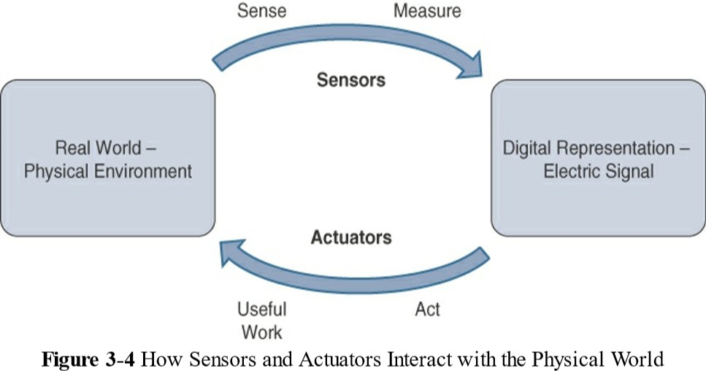
Actuators
21

Slide 22
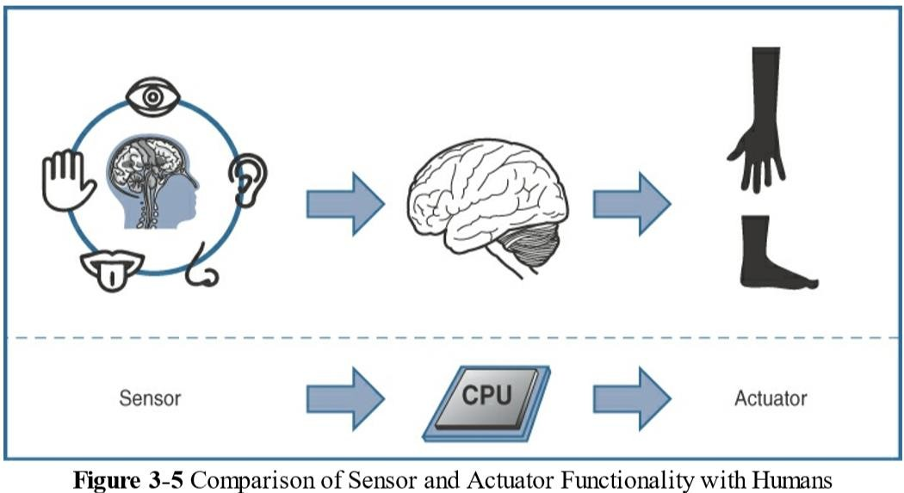
Actuators
22

Slide 23
Actuators
Actuators can be classified include the following:
Type of motion: Actuators can be classified based on the type of motion they produce (for example, linear, rotary, one/two/three-axes).
Power: Actuators can be classified based on their power output
(for example, high power, low power, micro power)
Binary or continuous: Actuators can be classified based on the number of stable state outputs.
Area of application: Actuators can be classified based on the specific industry or vertical where they are used.
Type of energy: Actuators can be classified based on their
energy type.
23

Slide 24
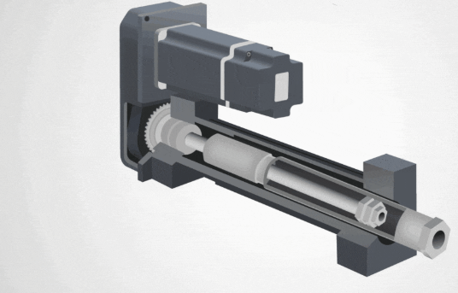
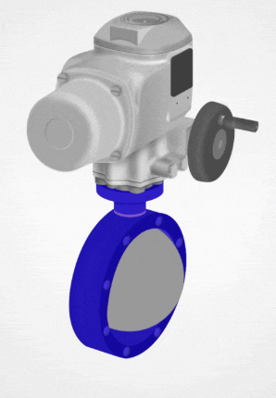

Slide 25
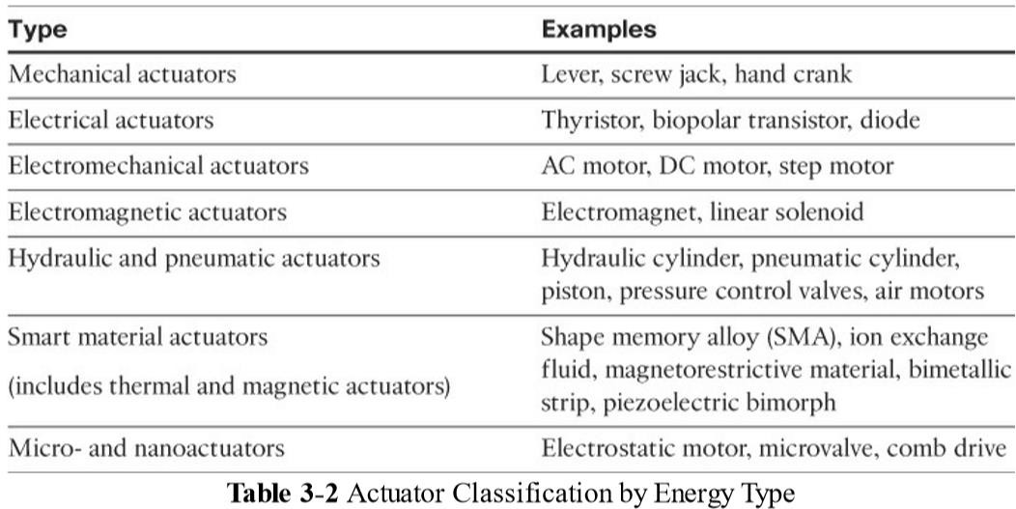
Actuators
4:17 PM
20

Slide 26
Micro-Electro-Mechanical Systems (MEMS)
Micro-electro-mechanical systems (MEMS), sometimes simply referred to as micro-machines, can integrate and combine electric and mechanical elements, such as sensors and actuators, on a very small (millimeter or less) scale.
The combination of tiny size, low cost, and the ability to mass produce makes MEMS an attractive option for a huge number of IoT applications.
For example,
inkjet printers use micropump MEMS.
Smart phones also use MEMS technologies like
accelerometers and gyroscopes.
26

Slide 27
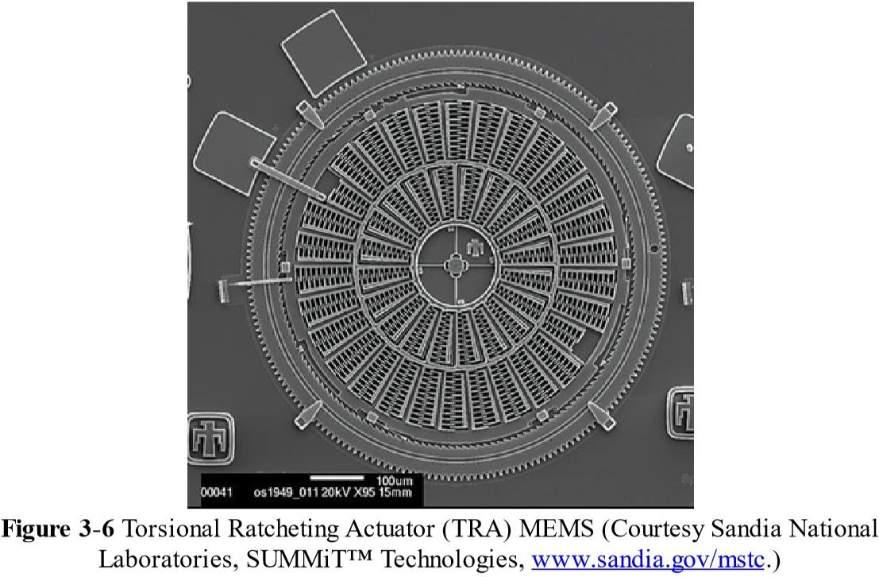
Micro-Electro-Mechanical Systems (MEMS)
27

Slide 28
Micro-Electro-Mechanical Systems (MEMS)
TRA (Torsional Ratcheting Actuator) MEMS is only a few hundred micrometers across;
– a scanning electron microscope is needed to show the level of detail visible in the figure.
Microscale sensors and actuators are immensely embeddable in everyday objects, which is a defining characteristic of IoT.
28

Slide 29
Smart Objects
Smart Objects are what transform everyday objects into a network of intelligent objects that are able to learn from and interact with their environment in a meaningful way.
Smart objects in IoT comes from being networked together rather than being isolated as standalone objects.
This ability to communicate over a network has a multiplicative effect and allows for very sophisticated correlation and interaction between disparate smart objects.
For example, the smart farming
If a sensor is a standalone device that measures the humidity of the soil, it is interesting and useful.
If that same sensor is connected as part of an intelligent network that is able to coordinate intelligently with actuators to trigger irrigation systems.
29

Slide 30
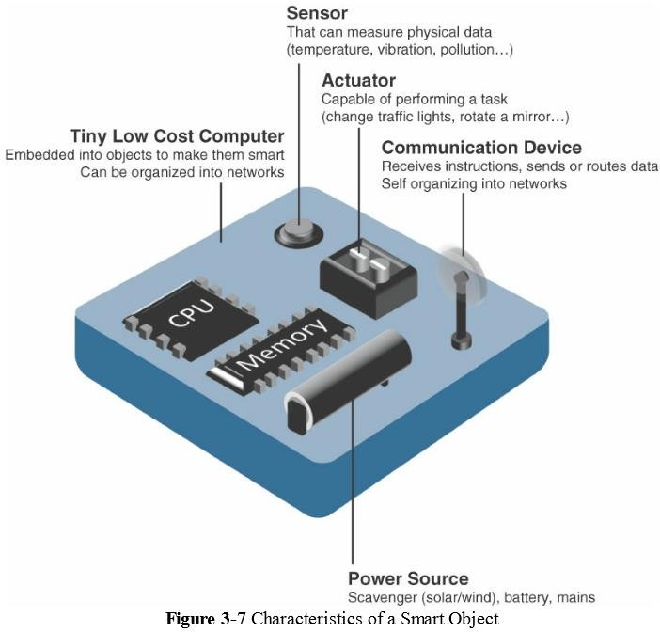
Smart Objects
30

Slide 31
Smart Objects: A Definition
Sensor(s) and/or actuator(s):
A smart object is capable of interacting with the physical
world through sensors and actuators.
A smart object can contain one or multiple sensors and/or actuators, depending upon the application.
Communication device:
The communication unit is responsible for connecting a smart object with other smart objects and the outside world (via the network).
Communication devices for smart objects can be either wired or wireless.
Overwhelmingly, in IoT networks smart objects are wirelessly interconnected for a number of reasons, including cost, limited infrastructure availability, and ease of deployment. There are myriad different communication protocols for smart objects.
31

Slide 32
Smart Objects: A Definition
Processing unit:
A smart object has some type of processing unit for
acquiring data, processing and analyzing sensing information
received by the sensor(s),
coordinating control signals to any actuators, and controlling a variety of functions on the smart object,
including the communication and power systems.
The specific type of processing unit that is the most common is a microcontroller because of its small form factor, flexibility, programming simplicity, ubiquity, low power consumption, and low cost.
32

Slide 33
Smart Objects: A Definition
Power source:
The most significant power consumption usually comes from the
communication unit of a smart object.
As with the other three smart object building blocks, the power requirements also vary greatly from application to application.
Typically, smart objects are limited in power, are deployed for a very long time, and are not easily accessible.
When the smart object relies on battery power, implies that power efficiency, judicious power management, sleep modes, ultra-low power consumption hardware, and so on are critical design elements.
For long-term deployments where smart objects are, for all practical purposes, inaccessible, power is commonly obtained from scavenger sources (solar, piezoelectric, and so on) or is obtained in a hybridized manner, also tapping into infrastructure power.
33

Slide 34
Trends in Smart Objects
Smart objects will always be application- dependent variability, but these are broad generalizations and trends impacting IoT:
Size is decreasing:
Some smart objects are so small they are not even visible to the naked eye. This reduced size makes smart objects easier to embed in everyday objects.
Power consumption is decreasing:
The different hardware components of a smart object continually consume less power. This is especially true for sensors, many of which are completely passive. Some battery-powered sensors last 10 or more years without battery replacement.
34

Slide 35
Trends in Smart Objects
Processing power is increasing:
Processors are continually getting more powerful and smaller.
So they become increasingly complex and connected.
Communication capabilities are improving:
Wireless speeds are continually increasing, but they are also increasing in range. IoT is driving the development of more and more specialized communication protocols covering a greater diversity of use cases and environments.
Communication is being increasingly standardized:
There is a strong push in the industry to develop open standards for IoT communication protocols. In addition, there are more and more open source efforts to advance IoT.
35

Slide 36
Case Study On Smart Parking
https://www.persistent.com/solution-video-quadcopter-smart-parking-using-ibm-watson-iot/

